Slide 1
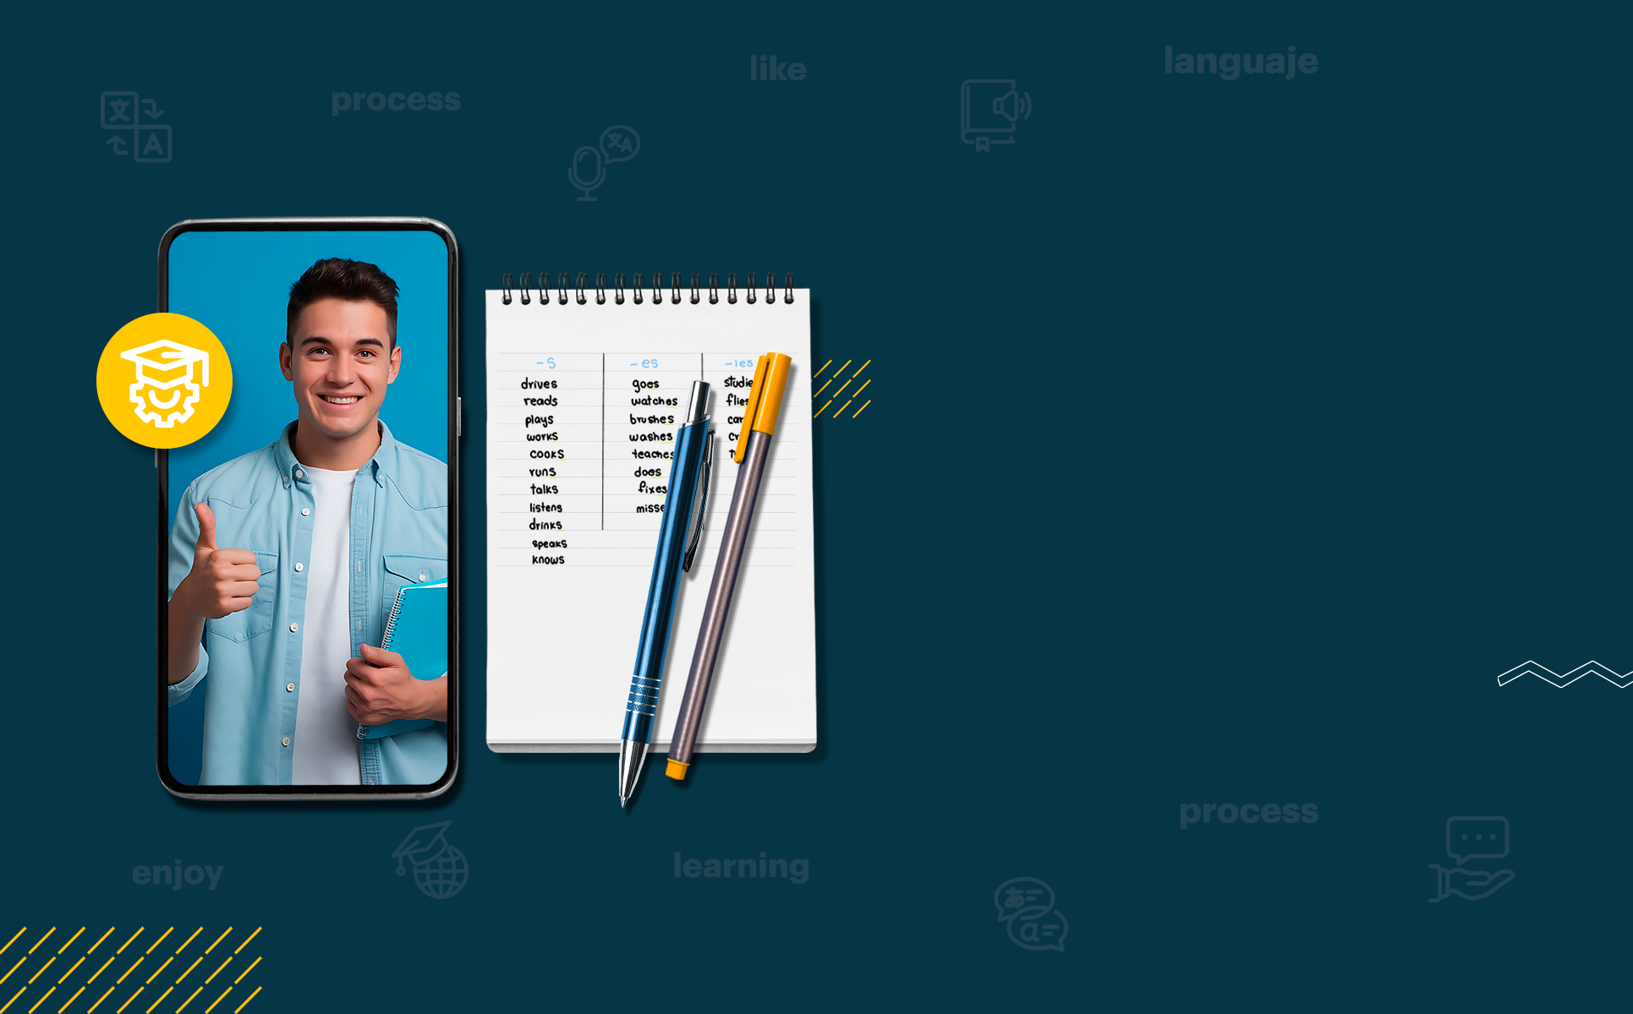

ENGLISH LEVEL B1 - II
Lesson 05
A VISIT TO THE BANK

Slide 2

01
Learn to talk about a visit to the bank
02
Using conditional sentences
ENGLISH LEVEL B1 - II

Slide 3
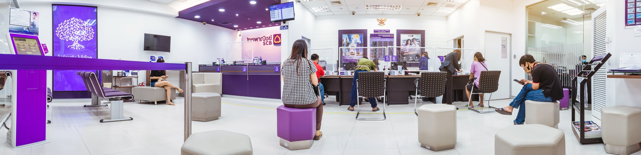
A VISIT TO THE BANK
A visit to the Bank Context
Read the following situations and answer the questions:
Situation A: You need to withdraw money, but you forgot your bank card.
Situation B: You want to open a bank account but don’t know the requirements.
Situation C: You are traveling abroad and need to exchange currency.
Discussion Questions:
How would you handle these situations?
What questions would you ask a bank teller?
Have you ever experienced a similar situation?

Slide 4
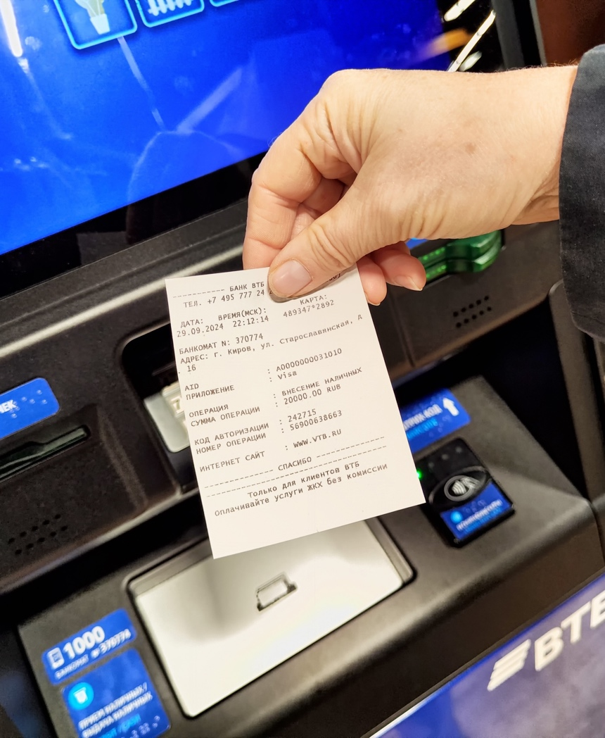
A VISIT TO THE BANK
Conditional Sentences
Zero Conditional: Used for facts and rules
"If you enter the wrong PIN three times, your card gets blocked.“
First Conditional: Used for future actions based on a condition
"If I don’t bring my ID, I won’t be able to open an account.“
Activity:
Complete the sentences using the correct conditional form:
If you _______ (lose) your bank card, you _______ (need) to report it immediately.
When you _______ (deposit) money, the bank _______ (give) you a receipt.
If the ATM _______ (not work), you _______ (have to) go inside the bank.

Slide 5
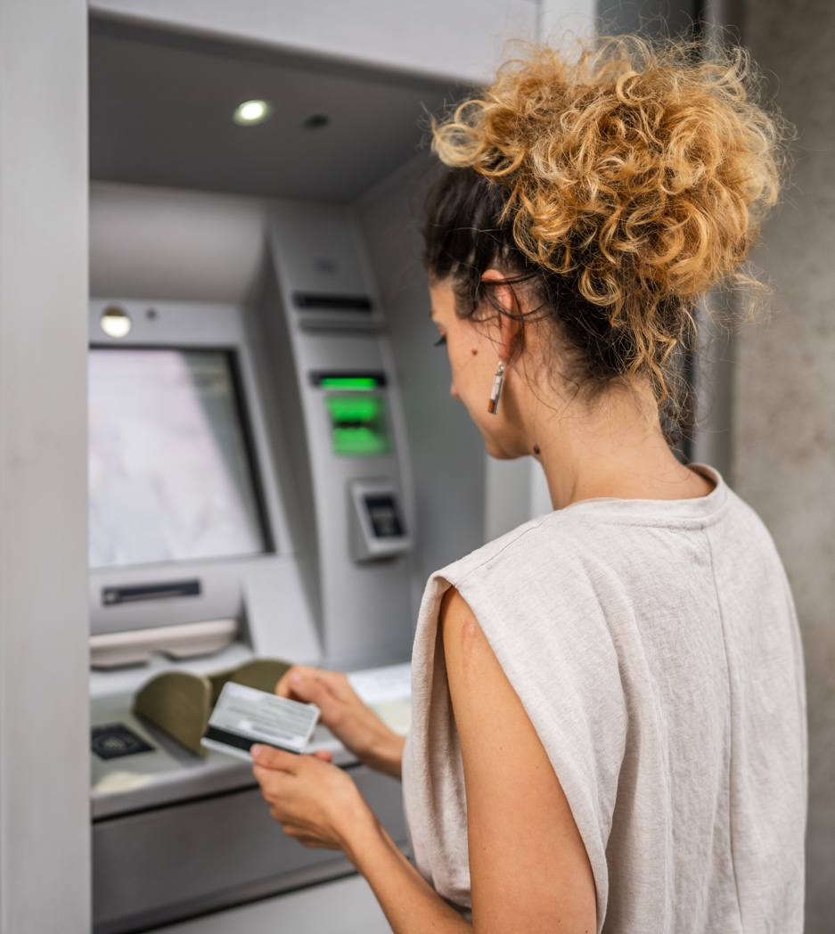
A VISIT TO THE BANK
Fill in the Blanks:
Role Play: work in pairs and create a short dialogue for each scenario, then share it to the class.
Scenario 1: A customer wants to open a new account but doesn’t know what documents are required.
Scenario 2: A customer is at the bank to report a lost credit card.
Scenario 3: A customer needs help withdrawing money from an ATM.
Instructions:
One student plays the customer, the other plays the bank employee. Switch roles.

Slide 6
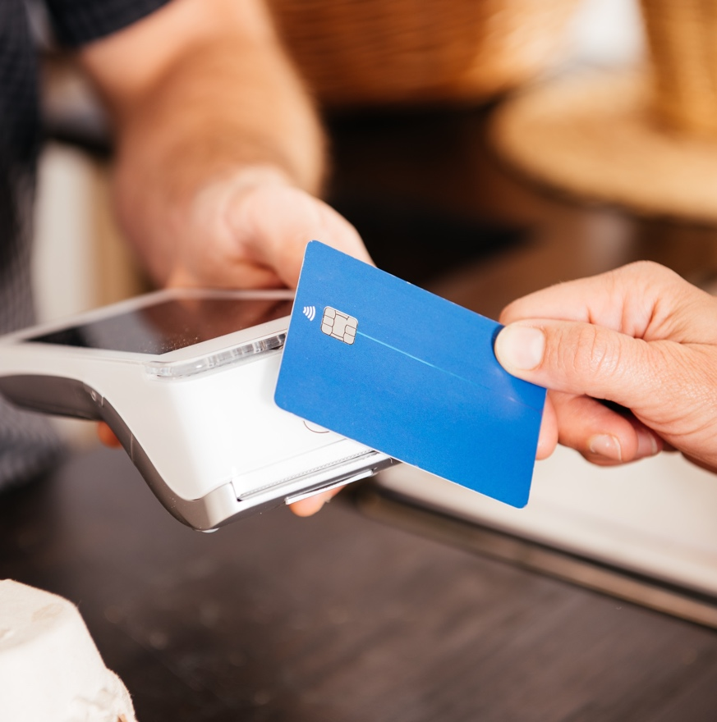

A VISIT TO THE BANK
CLASS DISCUSSION: REFLECT AND APPLY
What was the most useful phrase or grammar structure today?
Do you feel more confident talking about banking transactions?
What should you do if you lose your ATM card?
How do you ask about your account balance at the bank?
Complete: "If I deposit money today, it ________ (be) available tomorrow."

